Slide 1


WORK HUB PORTAL FOR PDMC
July 9, 2025

Slide 2
WHAT IS WORK HUB PORTAL?

Slide 3
Work Hub Portal is your centralized, web-based platform designed to streamline communication, manage essential information, and simplify administrative tasks within our organization. It currently features a Community Wall for interactive discussions, a dedicated section for Announcements to keep everyone informed, and a repository for Memos to ensure important memos are easily accessible.
The portal also helps you stay connected with upcoming happenings through its Upcoming Events calendar and celebrates colleagues with a list of Birthday Celebrants. For your convenience, the Work Hub Portal already houses the Certificate of Employment (COE) System, providing an automated and efficient way to request your employment certificates.

Slide 4
Looking ahead, the Work Hub Portal will expand its capabilities to integrate the PDMC Helpdesk for all your support needs and will host WTMS's leave filing and Shift Scheduling. Rest assured, your data privacy is a top priority, with the Work Hub Portal secured by multiple layers of authentication. Work Hub Portal is a web and intranet based application. (this can run even on mobile devices)

Slide 5
Certificate of Employment System

Slide 6

Understanding the PDMC Employee Portal: Navigating COE Requests
What is the COE System?
The COE system within the PDMC Employee Portal is a comprehensive, intranet/web-based platform designed to streamline the request, approval, and processing of Certificates of Employment.
It replaces traditional, often manual, methods with an efficient digital workflow, ensuring transparency and accountability at every stage. This system facilitates communication between employees, supervisors, and HR, making the entire COE life cycle more efficient.
This presentation will provide a comprehensive overview of the COE process, from the initial request by employees to the final approval and release by HR. We'll break down the responsibilities of each stakeholder – employees, supervisors/managers, and HR personnel – ensuring a clear understanding of the workflow.

Slide 7
Our discussion will cover:
How employees can submit COE requests through the portal.
The steps involved for supervisors and managers in reviewing and approving COE request
The critical role of HR in processing, printing, and managing the status of approved COEs
An explanation of the various COE types, such as Benefit Claim, Travel, Financial, or Training/Educational and the status tags used to track progress within the system, including On Process, On Hold, For Signing, For Releasing, Released, and Denied.
By the end of this presentation, you will have a clear understanding of how to efficiently navigate and utilize the PDMC Employee Portal for all COE-related matters.

Slide 8
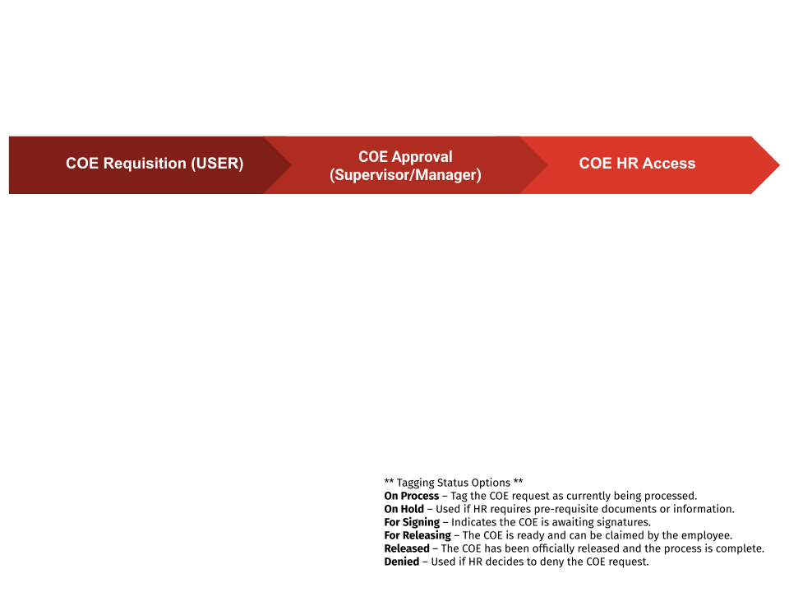

Slide 9
THE END

